Slide 1
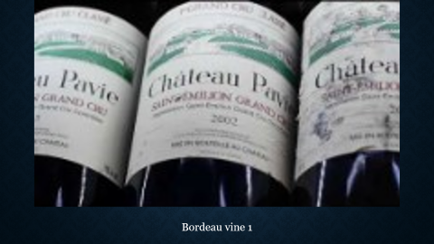
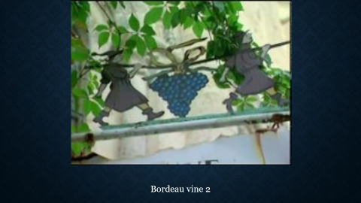
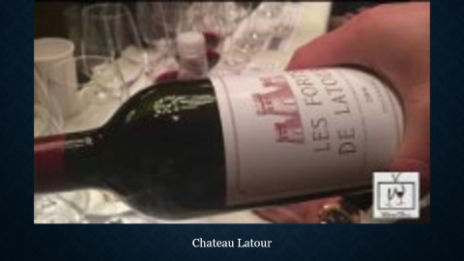


Turen går til
Franske vinslotte
Hjem

Slide 2

Chateau Malartic-Lagravière

Slide 3
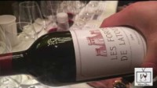
Chateau Latour

Slide 4
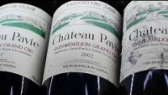
Bordeau vine 1

Slide 5
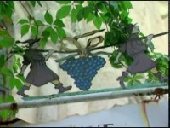
Bordeau vine 2

Slide 6
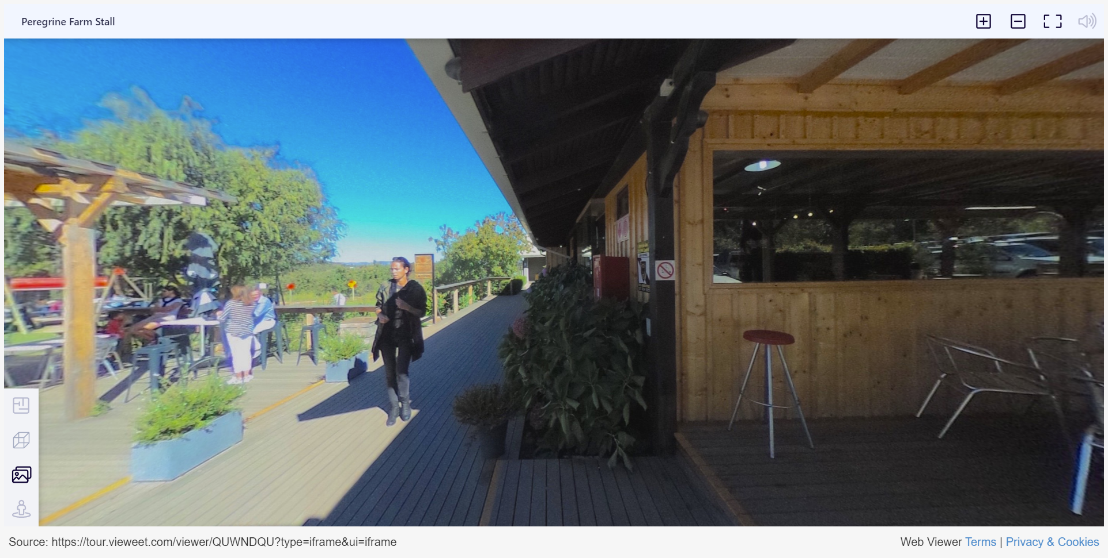
https://tour.vieweet.com/viewer/QUWNDQU?type=iframe&ui=iframe
Peregrine Farm Stall i Sydafrika 360+
http://www.wine360.world/virtually-there.html

