Slide 1




Preben Mejer
preben@mejer.com
Halvandet år
Hvordan gik det ☺ ☹
Hvad sker der nu

Slide 2
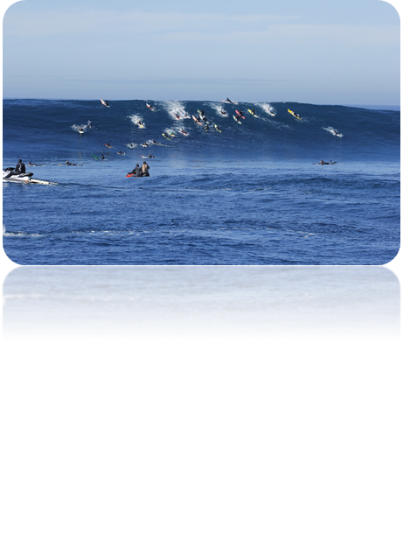



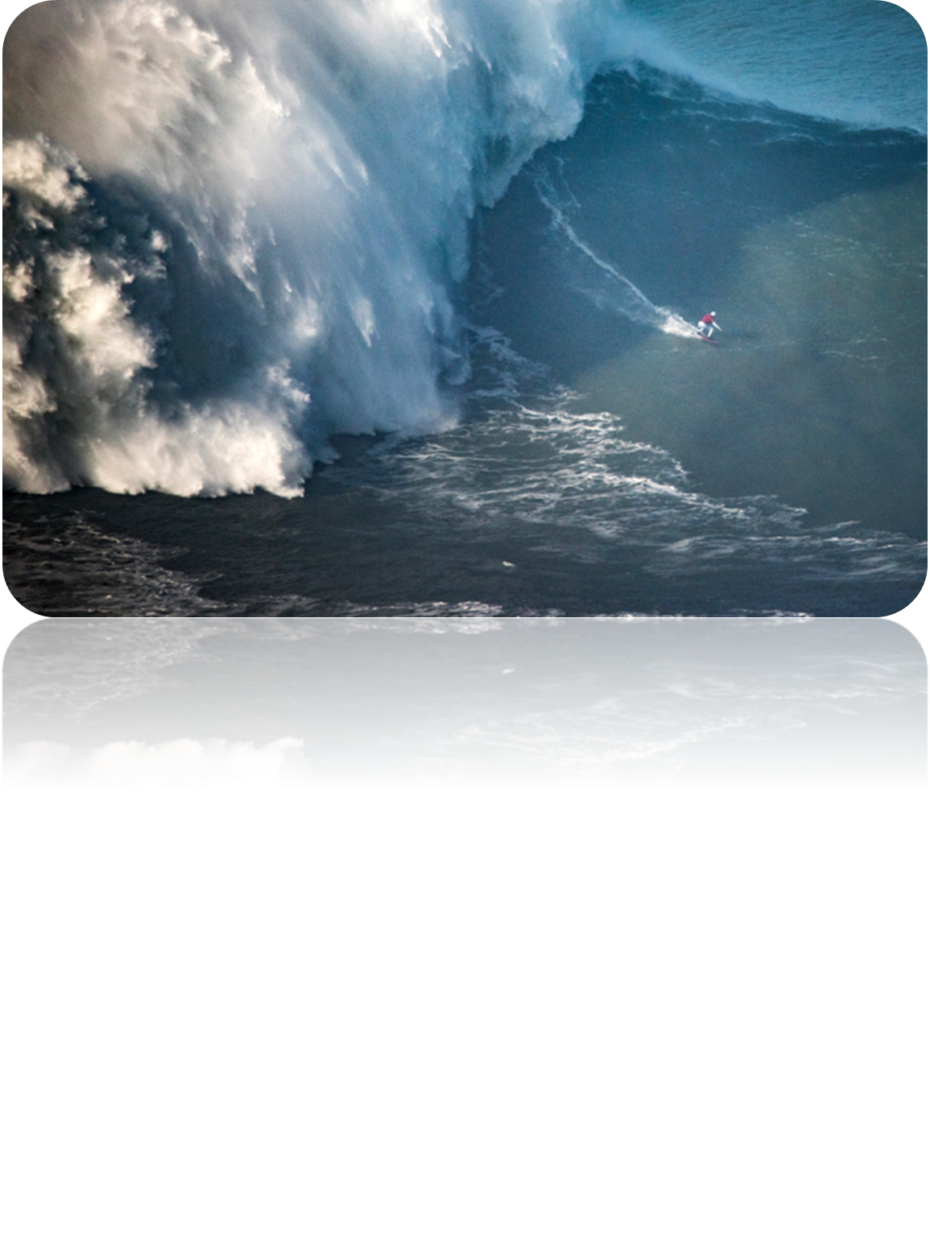

De største teknologispring…
Personal Computing
Internet
AI – Digital intelligens 2 år
Quantum Computing

Slide 3
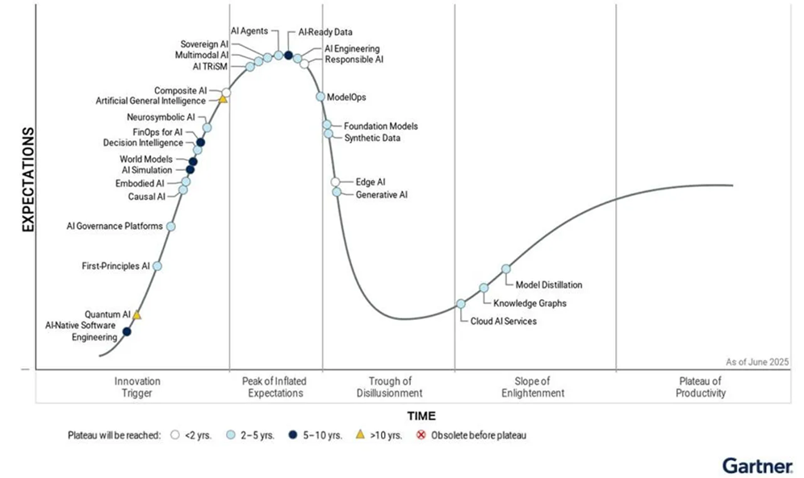

De største teknologispring…
Personal Computing
Internet
AI – Digital intelligens
Hype – 2 år
Computing
Gartner
Hype Kurve
Alan Turing – Enigma og AI 1948

Slide 4


De største teknologispring…
Personal Computing
Internet
AI – Digital intelligens
Next...
Quantum Computing
Det kunne være sjovt at tale om det næste, men….

Slide 5
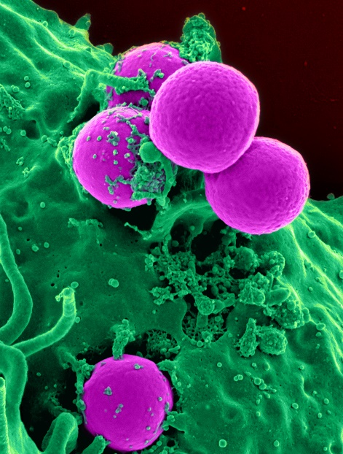

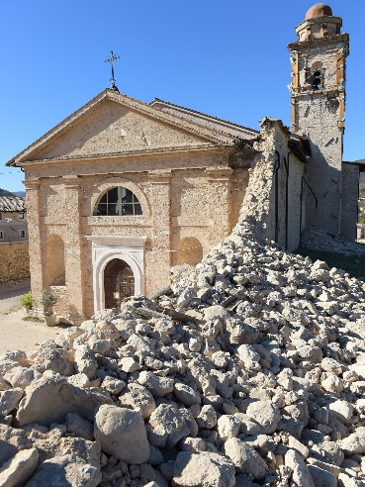
Overskue … AI baserede Forsknings gennembrud
Using AI to find first new antibiotic in 60 years
Fighting resistant bacteria
MRSA Staphylococcus, 35.000 deaths a year in Europe - MIT
Talking to Whales CETI – Cetacean Translation Initiative
Earthquakes
Tectonic plates grate against each other – was thougth to be noise
Highly predictable patterns
Estimating time to next earthquake Geophysical Research Letter - Los Alamos

Slide 6
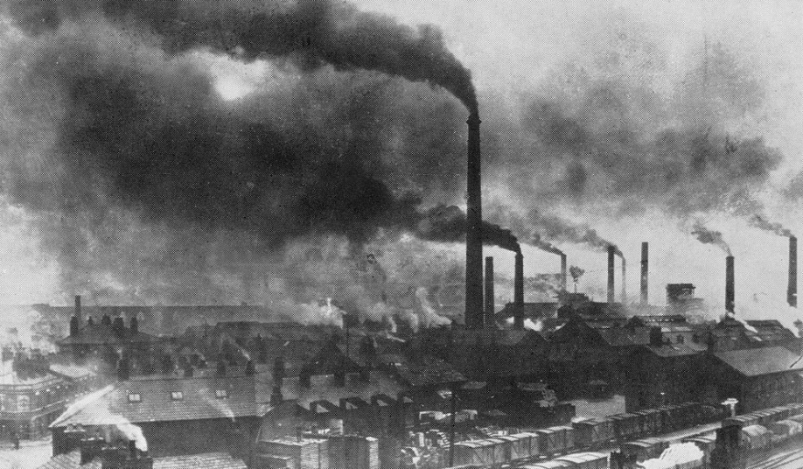

Potentiale …
WEF
Steam engine grew GDP 0.3 pct yearly
IT og Internet 0.6 pct
AI potential 1.3 pct
AI could increase annual GDP by 7 pct Goldman Sachs march 26th
GenAI kan løfte velstanden i Danmark 10 pct af BNP = 230-290 mia kr McKinsey
It’s not the tools it is the process
Internet, PC and software where tools
AI takes part of the process The Newyorker, Carl Newport

Slide 7

Potentiale …
WEF
Steam engine grew GDP 0.3 pct yearly
IT og Internet 0.6 pct
AI potential 1.3 pct
AI could increase annual GDP by 7 pct Goldman Sachs march 26th
GenAI kan løfte velstanden i Danmark 10 pct af BNP = 230-290 mia kr McKinsey
It’s not the tools it is the process
Internet, PC and software where tools
AI takes part of the process The Newyorker, Carl Newport

Slide 8
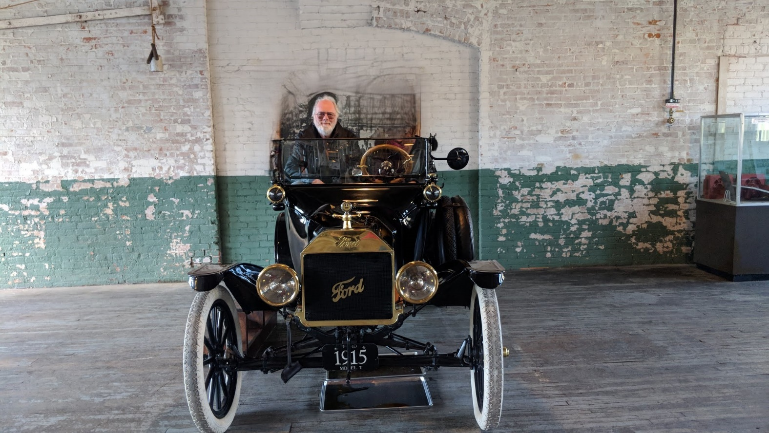
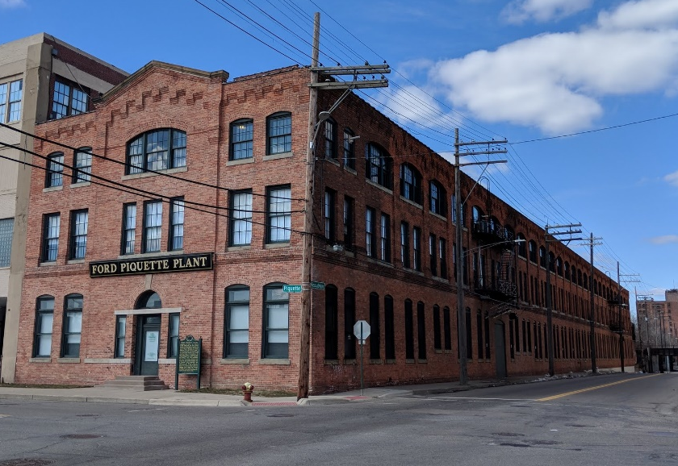

Potentiale …
WEF
Steam engine grew GDP 0.3 pct yearly
IT og Internet 0.6 pct
AI potential 1.3 pct
AI could increase annual GDP by 7 pct Goldman Sachs march 26th
GenAI kan løfte velstanden i Danmark 10 pct af BNP = 230-290 mia kr McKinsey
It’s not the tools it is the process
Internet, PC and software where tools
AI takes part of the process The Newyorker, Carl Newport .. Mere om det senere

Slide 9

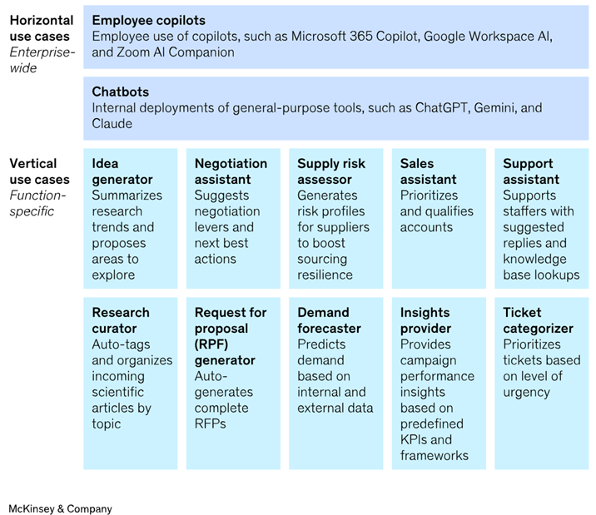
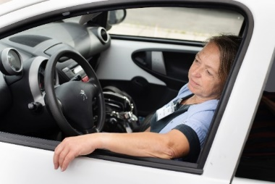
Potentiale … GDP
WEF
Steam engine grew GDP 0.3 pct yearly
IT og Internet 0.6 pct
AI potential 1.3 pct
AI could increase annual GDP by 7 pct Goldman Sachs
It’s not the tools it is the process
Internet, PC and software where tools
AI takes part of the process The Newyorker, Carl Newport

Slide 10
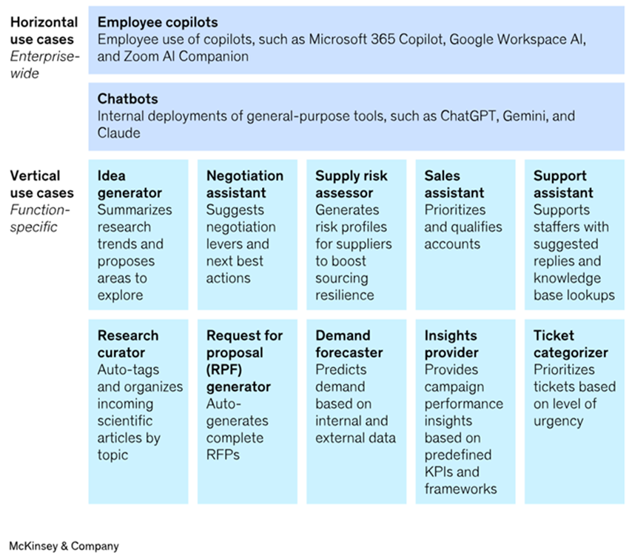

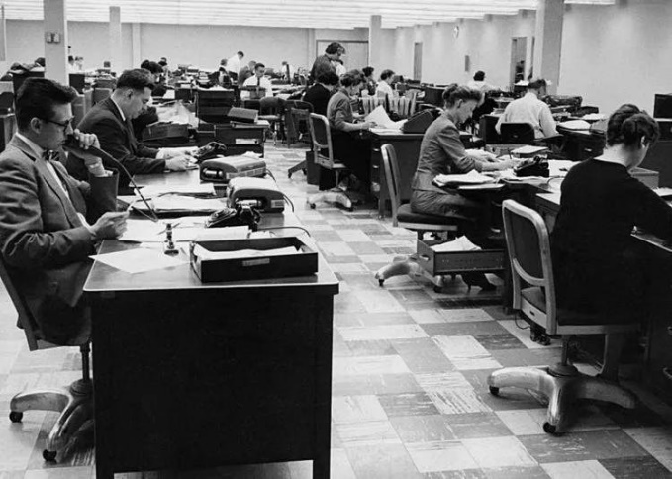
Copilot i England
UK Government - 20.000 average, not IT super users
82 pct of users want to continue using Copilot
70 pct report Copilot save time hunting for information
Avg public sector worker tasks
Drafting and summarizing
Documents / memos, reports, minutes
Managing routine admin workflows
Avg Copilot users save 26 minutes per day = 5 pct savings
UK govt Peter Kyle presentation at SXSW - Windows Forum

Slide 11

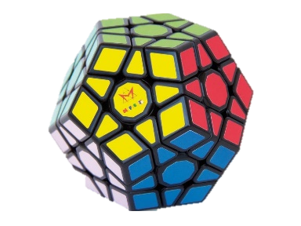
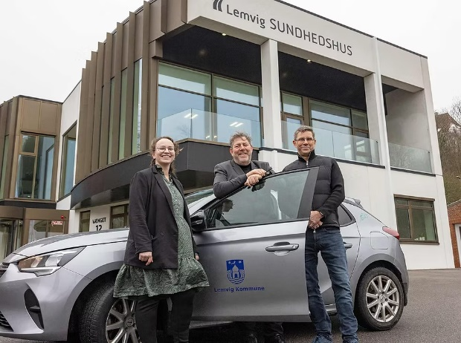
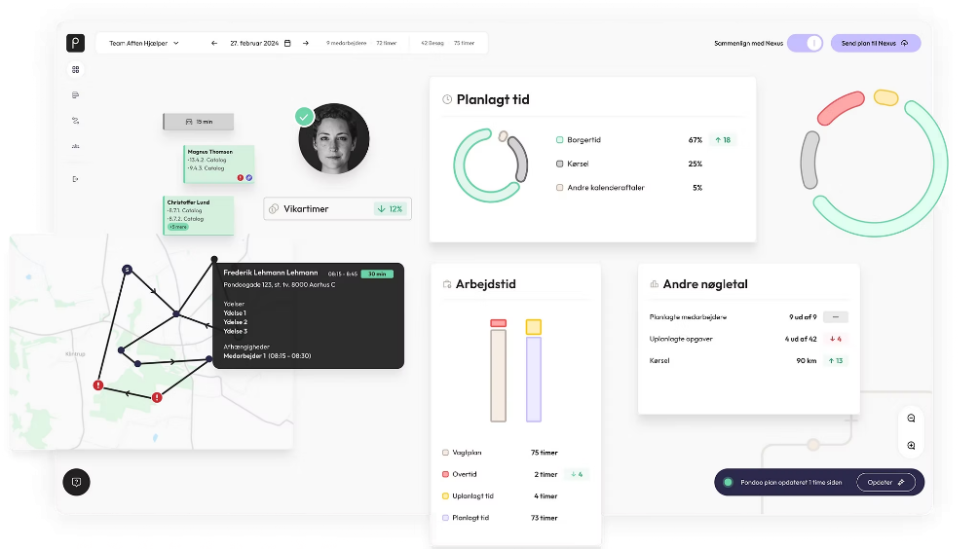
Pondoo i Lemvig
Machine Learning
Decision science
Ressource optimization
Pondoo / KMD
Homecare
Lemvig case
Op mod 30pct reduktion, time on the road
Borgerkontinuitet + 8pct
Danmarks 3die bedste kommune – hjemmepleje sept 2025

Slide 12

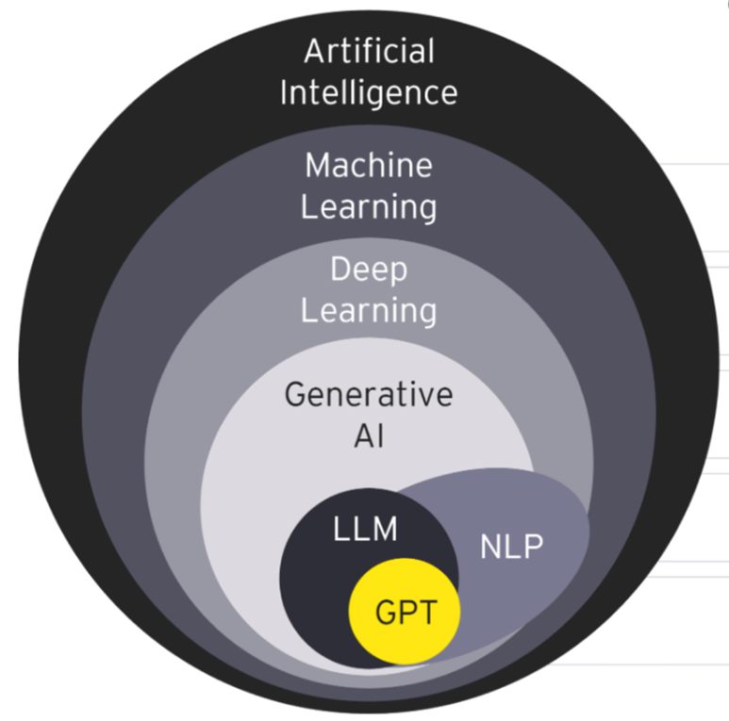



Og så… AI categories
Analytical AI / Machine learning
Machine learning algorithms based on data
make predictions, recommendations or decisions
Deep learning
Based on neural (brain like) structure
Generative AI / Generative adversarial networks
Two neural networks, one generating new data, one evaluating
Generator and discriminator work together, end result look like real data
GPT4 – Generative pretrained transformer
Pretrained on 175b parameters – internet – 2021 data (GPT3)
Transformer – can weight the significance of each part of input data
(BERT invented by Google)
LLM - Predict the next best word in a sentence
The first person to walk on the moon was…. Neil Armstrong
I want to help you..

Slide 13

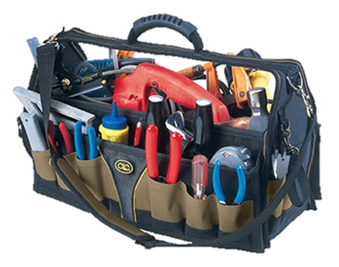


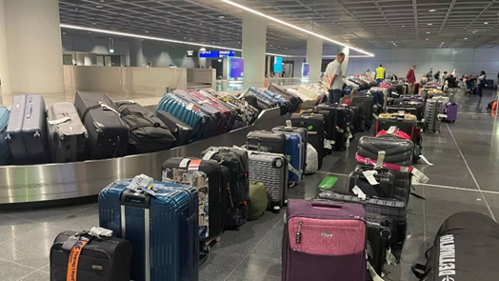
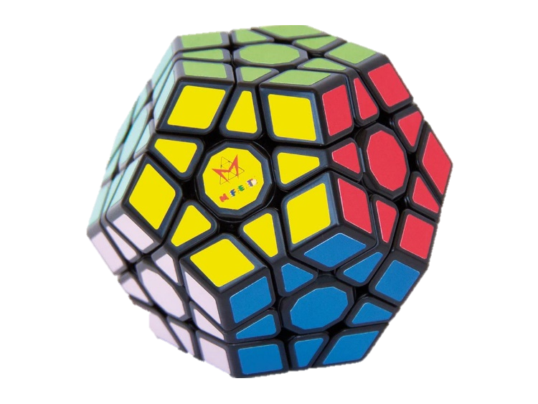
Ressource optimering
Qampo – Machine Learning
Decision science
Ressource optimization
Predictive analytics – Data/fortid
Decision optimization – Operations analyse/nutid
Intelligent UX/UI – Reduce complexity
Bagstage - CPH
8 incoming conveyor belts
35 pct better flow
Logistik
10-20 pct mere effektivt

Slide 14
AI categories
Analytical AI / Machine learning
Machine learning algorithms based on data
make predictions, recommentations or decisions
Deep learning
Based on neural (brain like) structure
Generative AI / Generative adversarial networks
Two neural networks, one generating new data, one evaluating
Generator and discriminator work together, end result look like real data
GPT4 – Generative pretrained transformer
Pretrained on 175b parameters – internet – 2021 data (GPT3)
Transformer – can weight the significance of each part of input data
(BERT invented by Google)
LLM - Predict the next best word in a sentence
The first person to walk on the moon was…. Neil Armstrong
I want to help you..

Slide 15

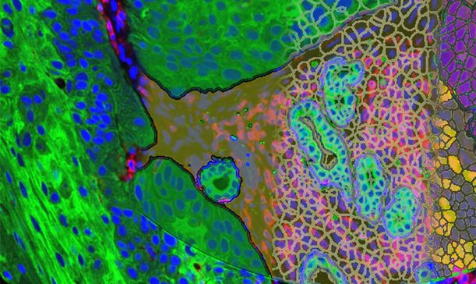
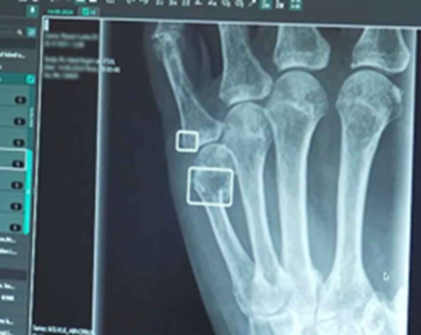
Beslutningsstøtte – Billed-analyse
Visiopharm - Biopsier
Delivers tissue data mining tools, precision results, and workflows.
Region Nordjylland - røntgenbilleder på akutmodtagelser.
”Vi synes, det fungerer supergodt. Før var ventetiden i gennemsnit fem timer. Nu er den fire” overlæge på Aalborg Universitetshospital Christian Pedersen / DR
SmartUrgencies.

Slide 16

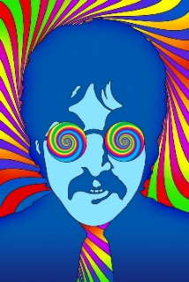
AI categories
Analytical AI / Machine learning
Machine learning algorithms based on data
make predictions, recommentations or decisions
Deep learning
Based on neural (brain like) structure
Generative AI / Generative adversarial networks
Two neural networks, one generating new data, one evaluating
GPT5 – Generative pretrained transformer
(GPT3) Pretrained on 175b parameters – internet
Transformer – can weight the significance of each part of input data
(LLM - Predict the next best word in a sentence

Slide 17
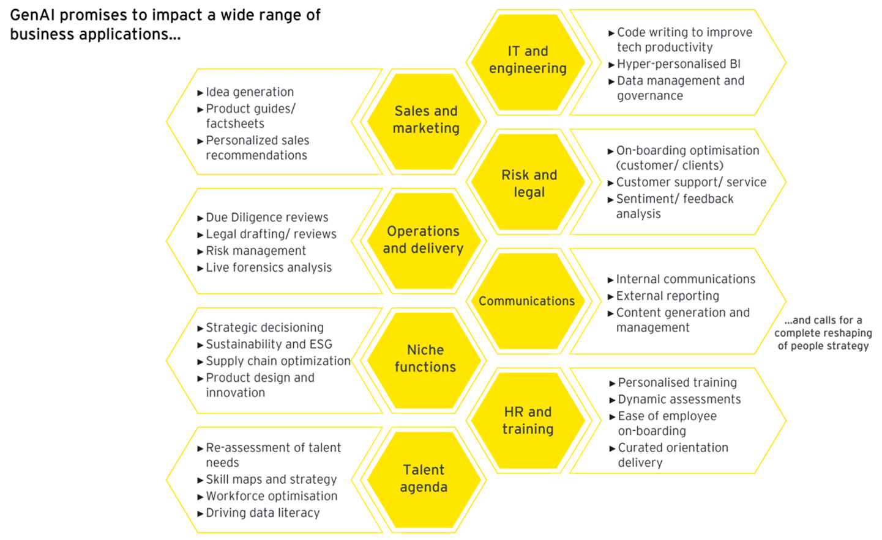


GPT Generative AI Copilot m.m. Prompting
Gen AI LLM capabilities
Abstract
Expand
Chatbots
Extracting
Transformation
Som at få en pissebegavet kollega
Altid klar til at hjælpe dig Jan Birkemose, journalist / Børsen / KL

Slide 18
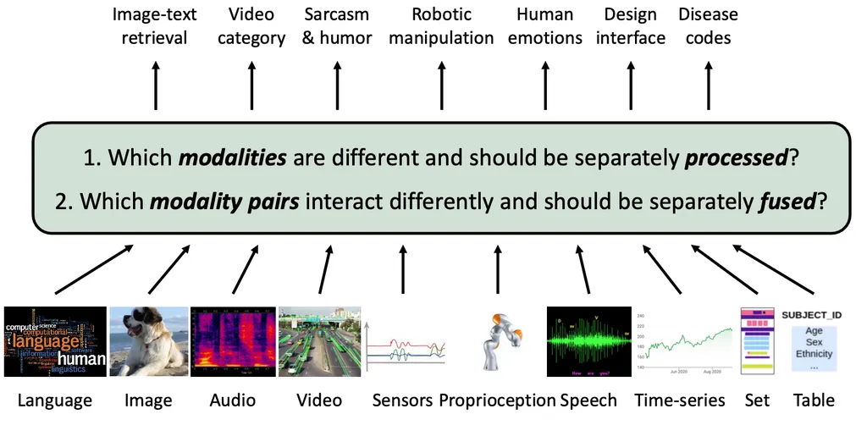
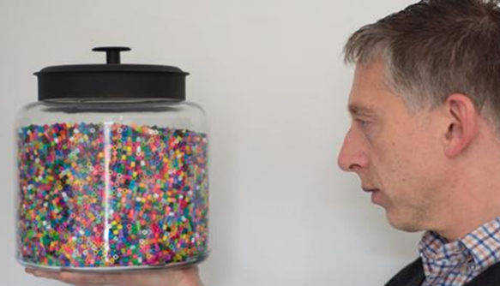
GenAI 2025 Modality Agnostic
GPT4o text, image, audio in a unified format
Not bolted on to LLM
Same backbone
Can express itself using images
Can adapt visual templates, cosmetics ad becomes bakery ad
Bring drawings to life or video
From LLM to
Modality agnostic

Slide 19
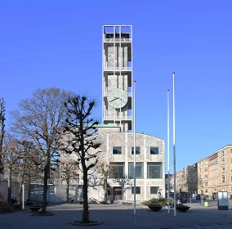
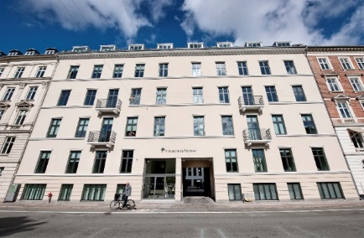
Generativ AI AI støtte til call center
Aarhus Kommune
Borger henvendelser, systemet trækker automatisk relevante vejledninger frem til medarbejderen på baggrund af samtalen
Reducerer kravene til paratviden hos medarbejder, og giver hurtigere svar KL

Slide 20
Deep Learning Beslutningsstøtte Smart Urgencies
Region Nordjylland bruger AI til at analysere røntgenbilleder på akutmodtagelser. SmartUrgencies.
”Vi synes, det fungerer supergodt. Før var ventetiden i gennemsnit fem timer. Nu er den fire” overlæge på Aalborg Universitetshospital Christian Pedersen / DR

Slide 21
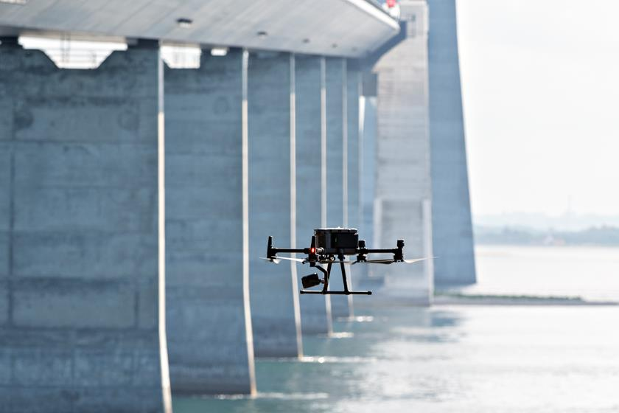
Vedligehold Inspektion
Sund & Bælt inspektion og vedligehold
AI Løsning genkender betonskader
Besparelse på inspektionsomkostninger på 50 pct
Systematisk inspektion kan forlænge broens levetid med 50-100 år
Alexandra Instituttet
Droneinspektion af vindmøller 1:8

Slide 22
Hermed er Classic AI Framework – Opfyldt
Analytical AI / Machine learning
Machine learning algorithms based on data
make predictions, recommentations or decisions
Deep learning
Based on neural (brain like) structure
Generative AI / Generative adversarial networks
Two neural networks, one generating new data, one evaluating
GPT5 – Generative pretrained transformer
(GPT3) Pretrained on 175b parameters – internet
Transformer – can weight the significance of each part of input data
(LLM - Predict the next best word in a sentence

Slide 23
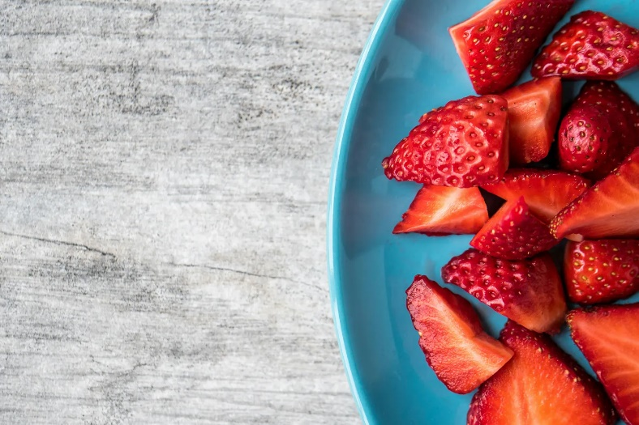
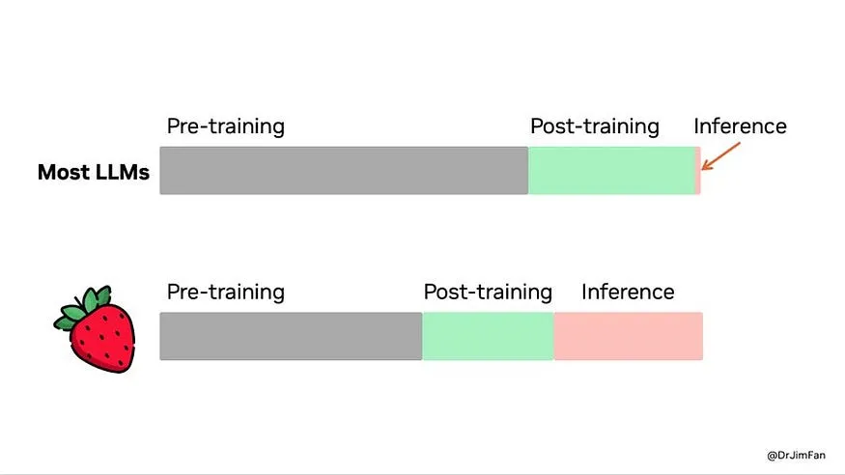

Overskue, Copilot, og nu… Fra tool to teammate Fra prompt til ræsonnement
Den store Klinge ….
Agentic – arbejder selvstændigt
Breaking Down Complex Problems
Deconstruct challenging tasks into simpler, more manageable step
Use Chain of thought to solve a problem
Learns to recognize and correct its mistakes

Slide 24
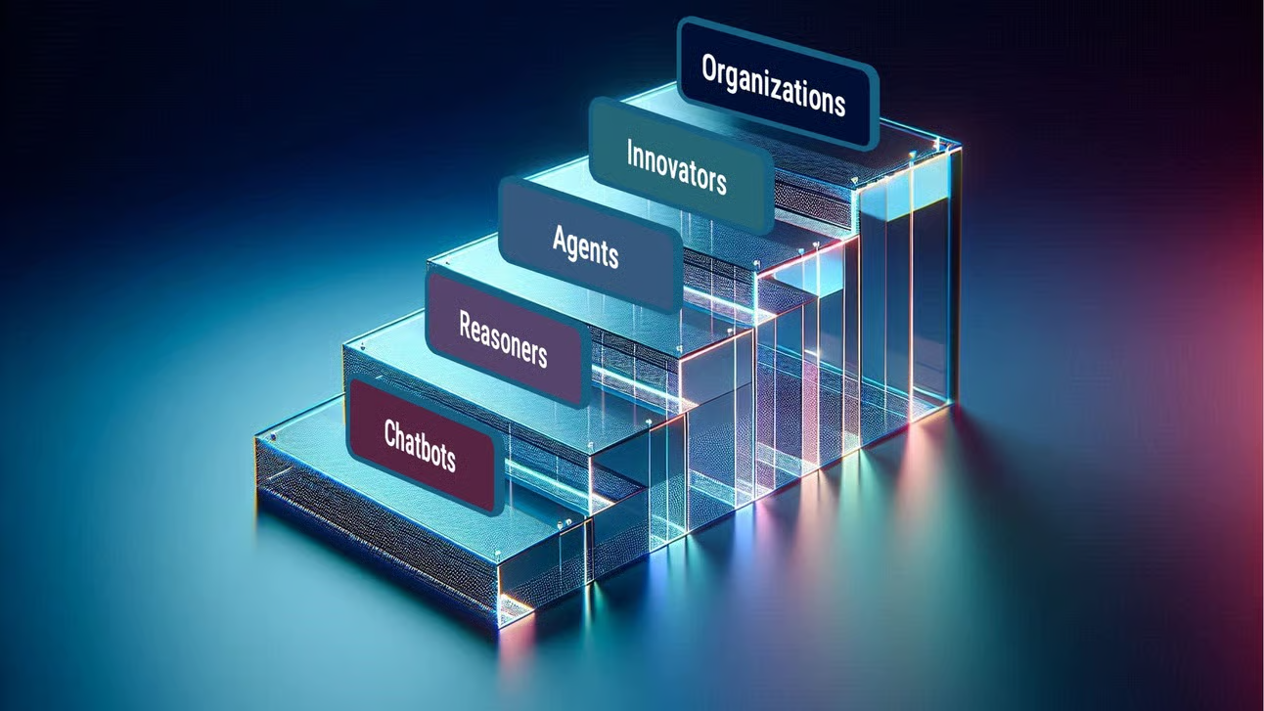
Nyt AI Framework – 5 trin - vi er på 3die
Open AI 2024
Conversational
Reasoners
Agents – execute tasks, make decisions, work on their own over several days
Agentic AI Definition…
Focused on autonomous decision-making and action.
Traditional AI, primarily responds to commands or analyzes data
Agentic AI can set goals, plan, and execute tasks with minimal human intervention – Google Deepmind
Immersive eller en del af UX

Slide 25
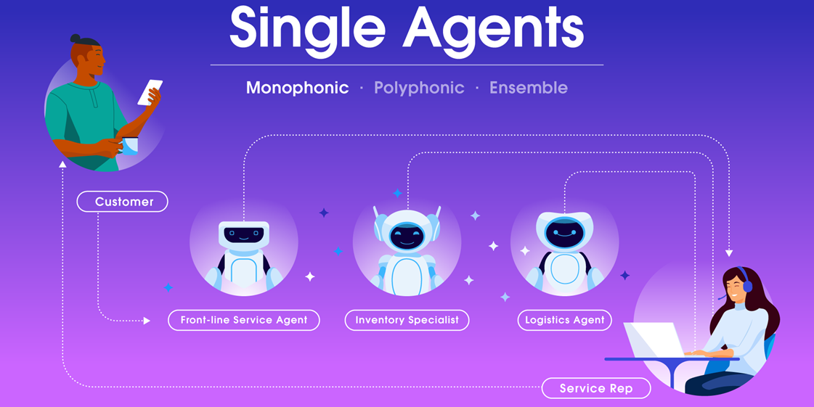
Fra prompt til agentic – the ability to act
Agentic – the ability to act
Agent: An AI-powered system that can
Reason, plan
Act to complete tasks or entire workflows
Autonomously, with human oversight at key moments.
Perform all kinds of tasks autonomously
Make decisions
Solve problems
Do shopping
Negotiate contracts
Book your travels,
Remember your preferences in hotels and, check your calender and select best flight,
Make a list of what to pack
What to see, book restaurants.
Look in your to do lists and meeting summaries
Executing tasks, booking meetings, sending mails and memos.
Tech Review / Angel Molina Laguna medium

Slide 26


Flere definitioner…. The Holy Grail - AGI
Artificial general intelligence (AGI)
Intelligence of a machine that can accomplish any intellectual task that a human can perform Gartner
OpenAI definition of AGI
Autonomous system outperforms humans in most economically valuable tasks
Open AI contract with Msft says AGI is achieved when AI has ABILITY to generate 130b in profits
Msft will then lose exclusive rights to OpenAI technology
Microsoft - Satya Nadella says there will be AGI when
We see a productivity leap that grows global GDP by 10 pct
Everything else is pure benchmark hacking
EU AI act
Category of general purpose AI models with one billion parameters
Means systemic risk territory security and transparency obligations
3 conflicting views of AGI
Open AI - a mystical one
Microsoft an economic one
EU a legal techical one Medium

Slide 27
Flere definitioner…. The Holy Grail - AGI
Artificial general intelligence (AGI)
Intelligence of a machine that can accomplish any intellectual task that a human can perform Gartner
OpenAI definition of AGI
Autonomous system outperforms humans in most economically valuable tasks
Open AI contract with Msft says AGI is achieved when AI has ABILITY to generate 130b in profits
Msft will then lose exclusive rights to OpenAI technology
Microsoft - Satya Nadella says there will be AGI when
We see a productivity leap that grows global GDP by 10 pct
Everything else is pure benchmark hacking
EU AI act
Category of general purpose AI models with one billion parameters
Means systemic risk territory security and transparency obligations
3 conflicting views of AGI
Open AI - a mystical one
Microsoft an economic one
EU a legal techical one Medium
3 conflicting views of AGI
Open AI – an expectation
Microsoft an economic one
EU a legal techical one Medium

Slide 28
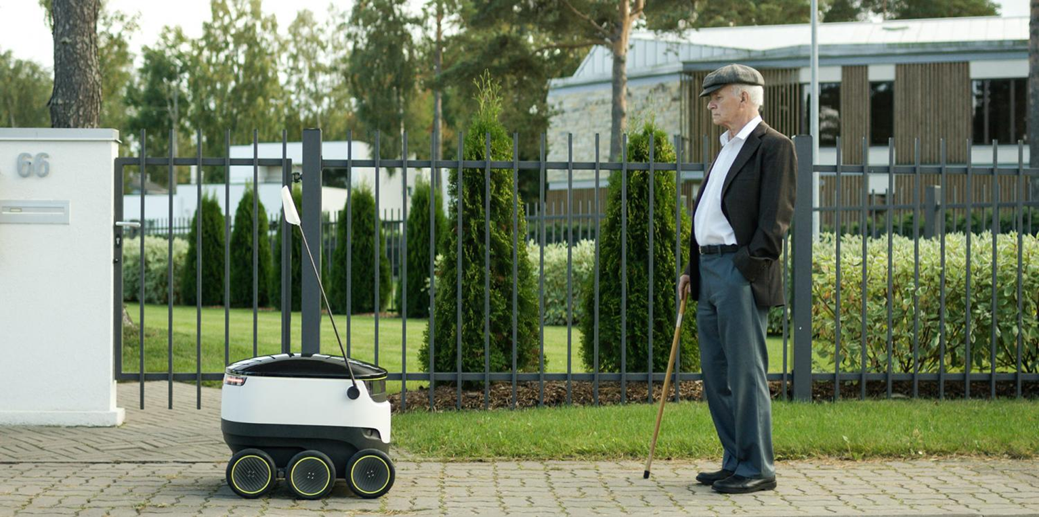
Robots

Slide 29
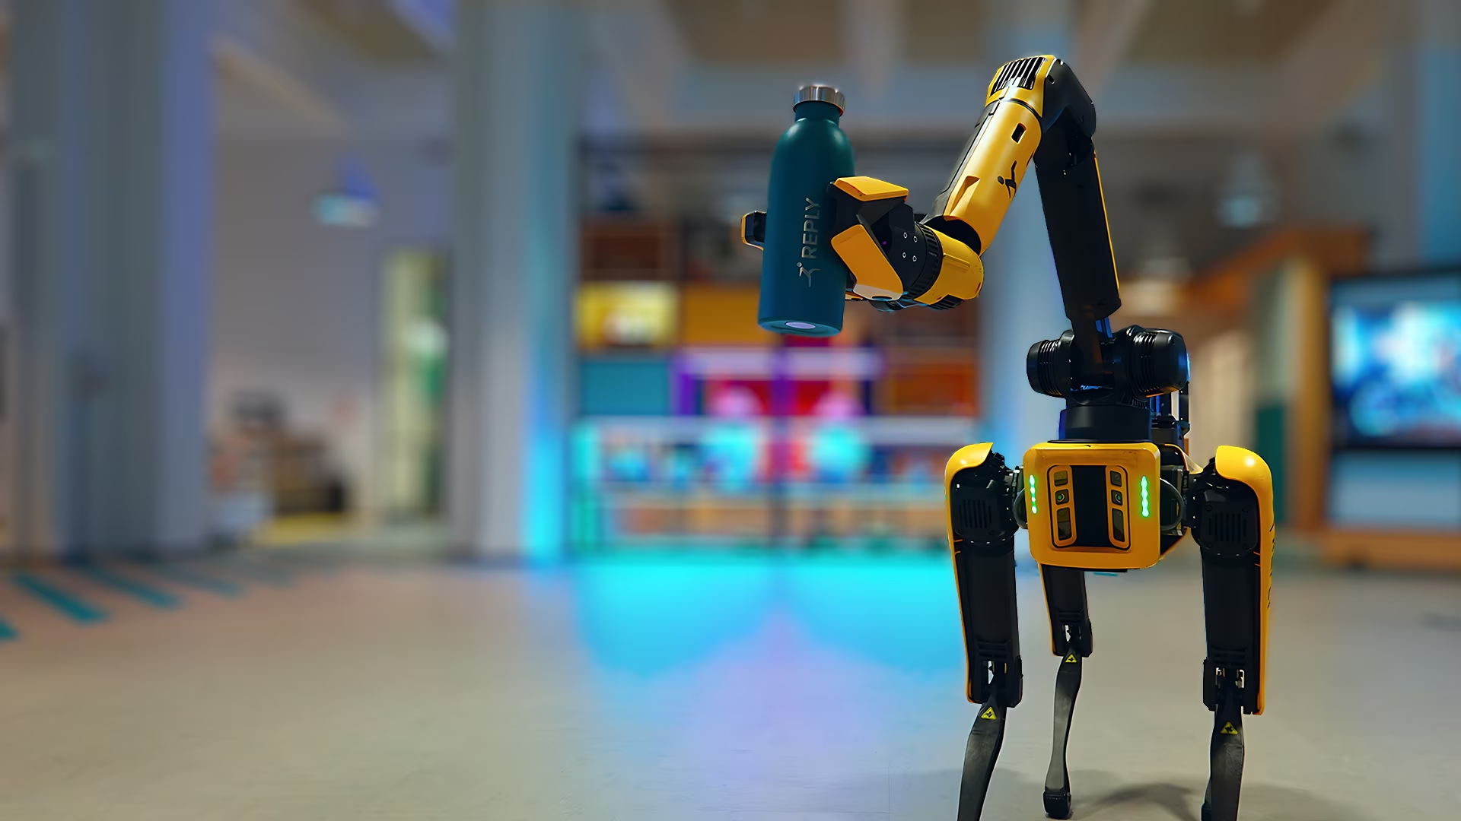
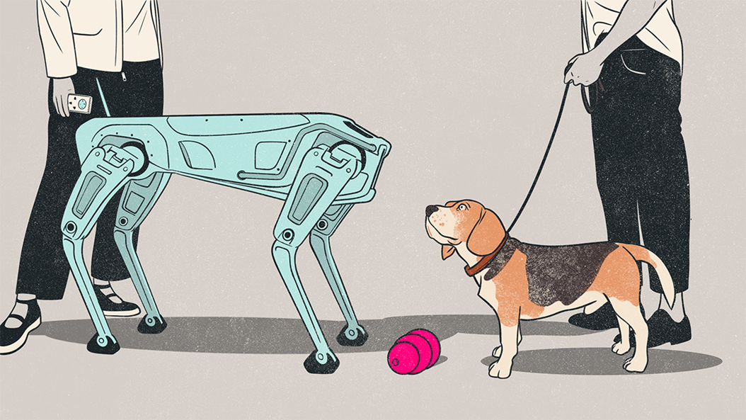
Hardware ændrer sig med Physical AI State of The Union
kommer vidt omkring

Slide 30

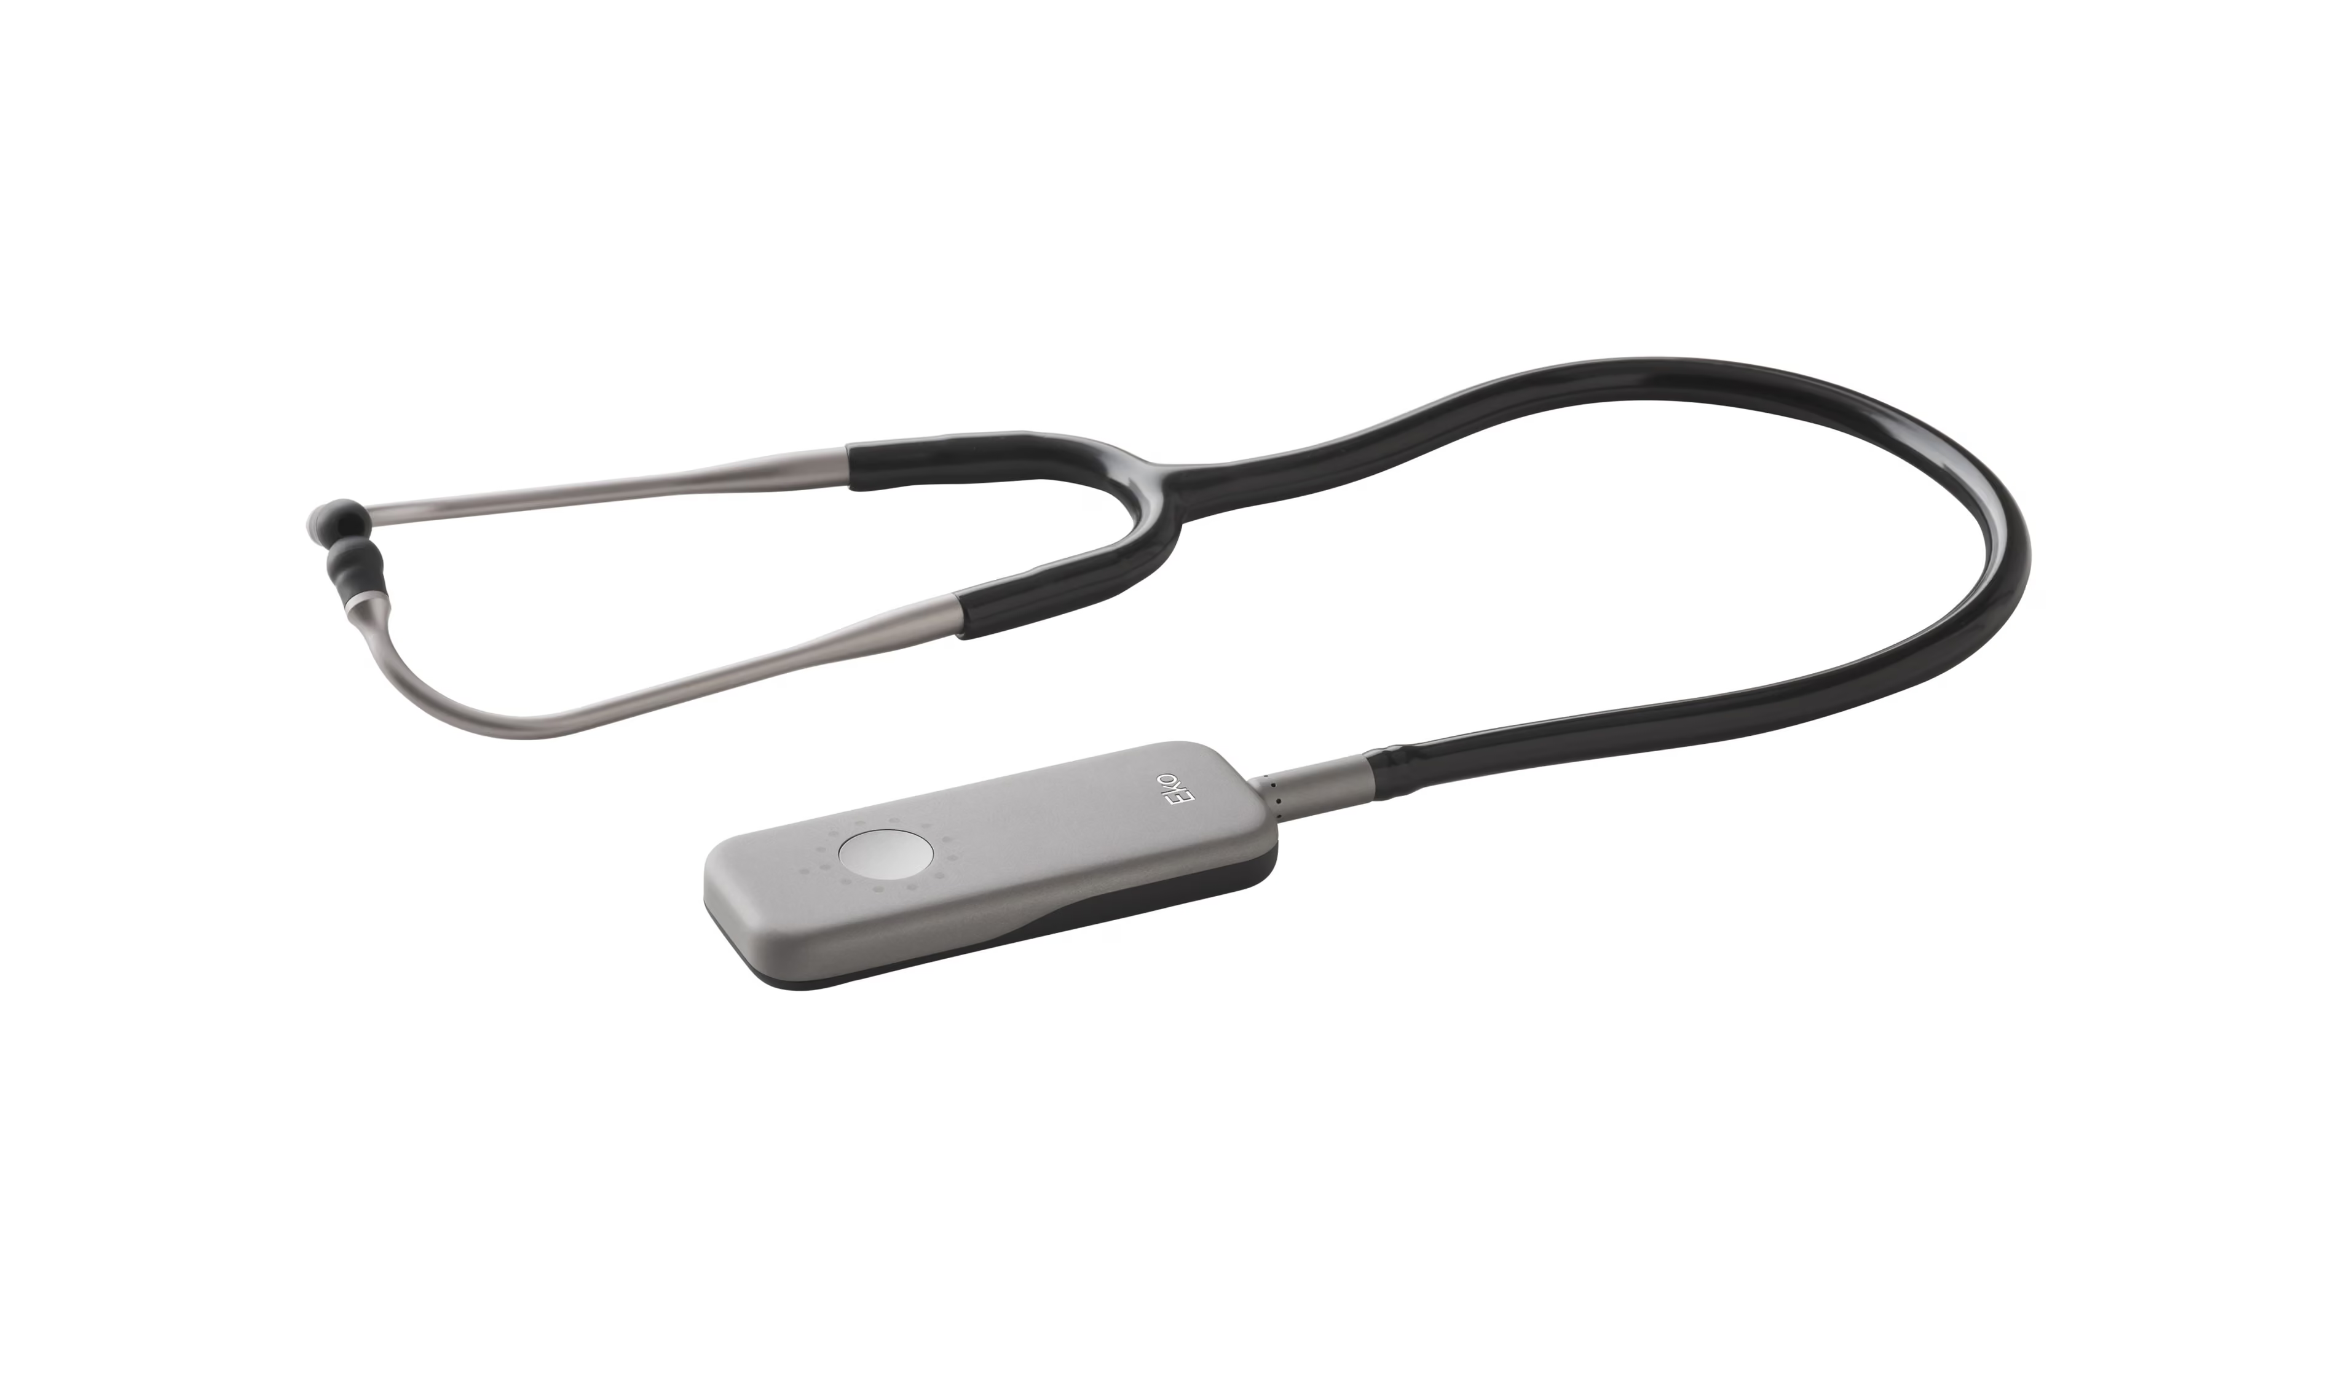
Ting bliver kloge Stetoskop
Stetoskop Eko Health
AI stethoscope, can detect major heart conditions in 15 seconds
2-3 times as likely to detect heart failure, atrial fillibration, heart valve disease
Can analyse tiny differences in heartbeat and blood flow undetectable to the human ear
Can take a rapid ECG
Imperial College London / Guardian

Slide 31

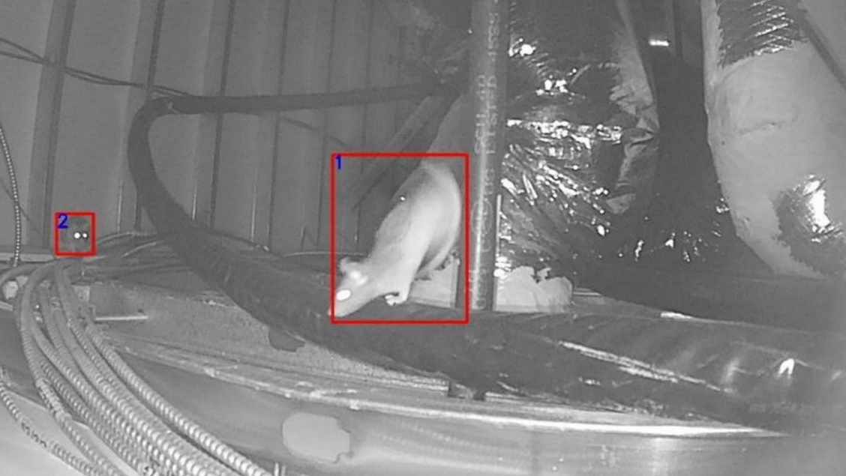
Ting bliver kloge Rottefælder
Rats work in teams
Male alpha rats are the leaders, and lower ranking rats make up the rest of the social group.
Rat facial recognition
Where do they come from, who is returning, who is making the damage
Rentokil
Guardian

Slide 32
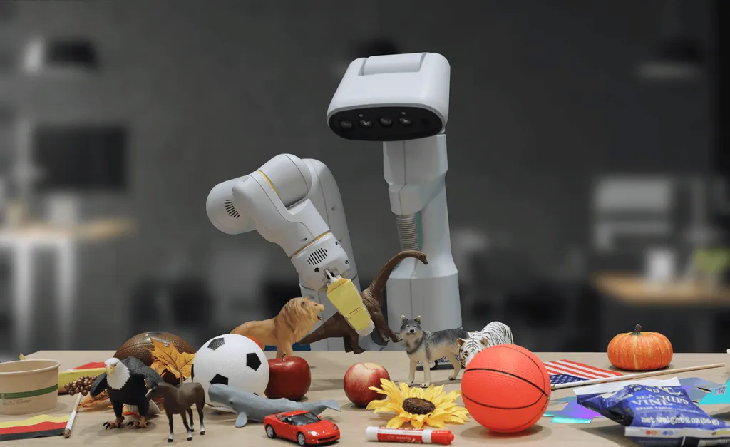
Google RT2
Google Deepmind RT2 Robotics-transformer model
Robots that can follow real-time instructions
Navigate any new environment on the fly
Medium

Slide 33
Google Gemini Robotics
Gemini Robotics
Can adapt, problem solve, pass skills between them
From systems that act on commands
To systems that can reason, plan, use tools, and generalize
Can
Sort laundry by color
Pack suitcase, looking up weather forecast
Sort trash, check local trash rules
Two models working together
Vision language action VLA model, turn visual information into commands
Vision language model create multistep plans Decrypt

Slide 34
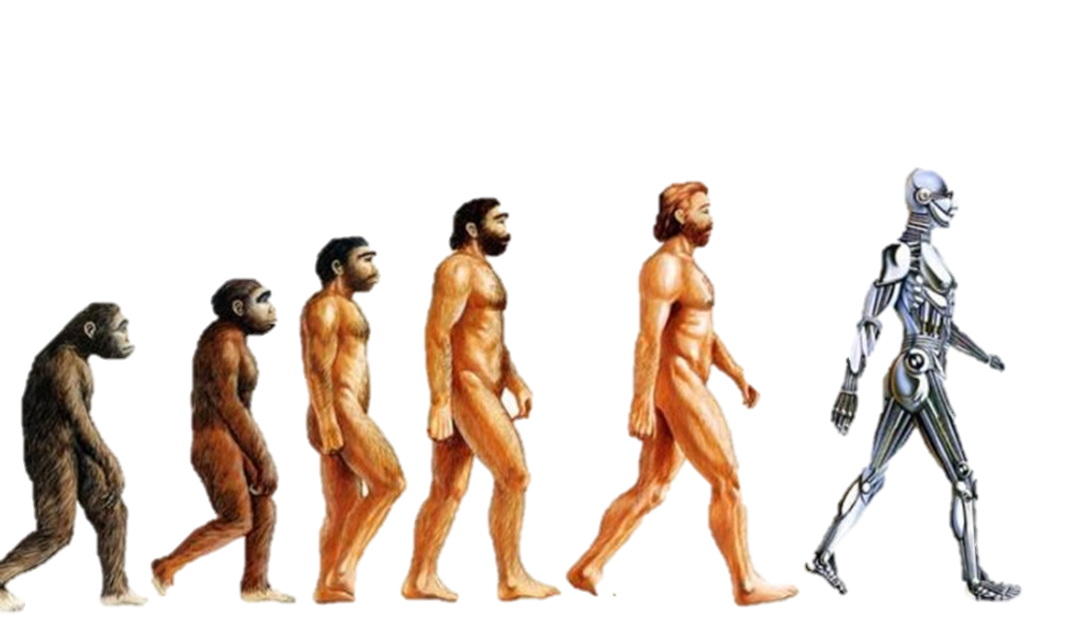
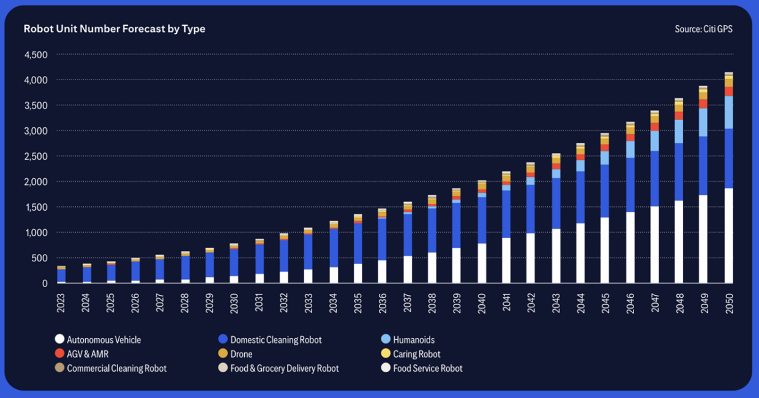

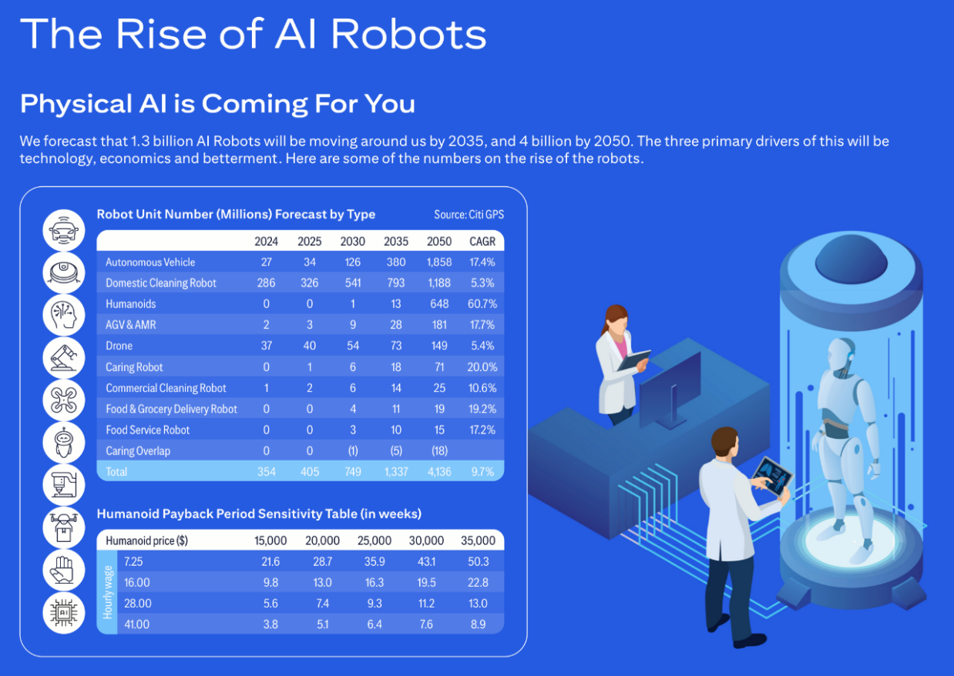
Physical AI Rise of the Robots
1.3b robots 2030
4b robots 2050
1.8b autonomous cars
1.2b manual cars
AGV automatic guided vehicles 181m
Cleaning 1.2b
Humanoids 650m
Assistive Care, Companionship, Delivery robots 71m
Citi
By 2030, 80% of humans
will engage with smart
robots on a daily basis,
up from less than 10% today. Gartner

Slide 35
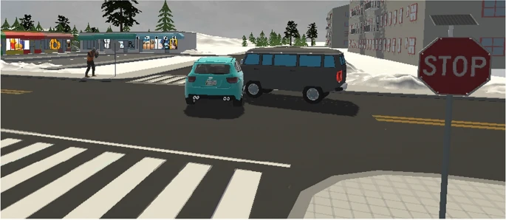
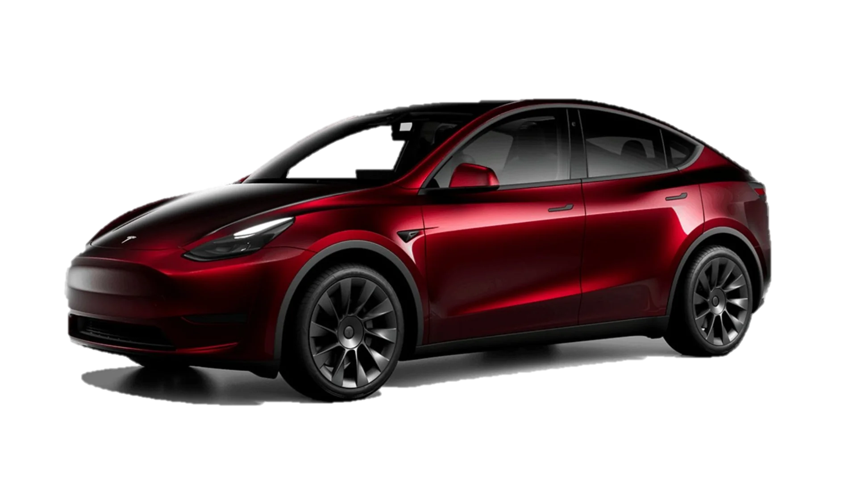
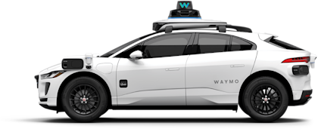
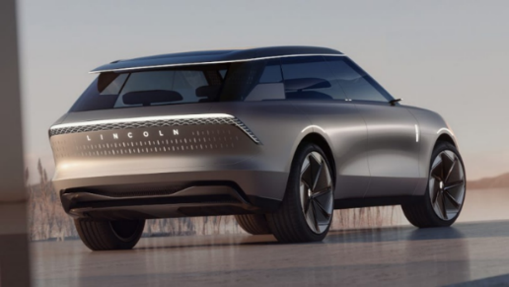
AV 2 (køre) skoler
Tesla AV – cowboy strategi
Use cameras / AI to react to road conditions like human
Less training and road mapping
Waymo / Google – deep / extensive
Mapping and training

Slide 36
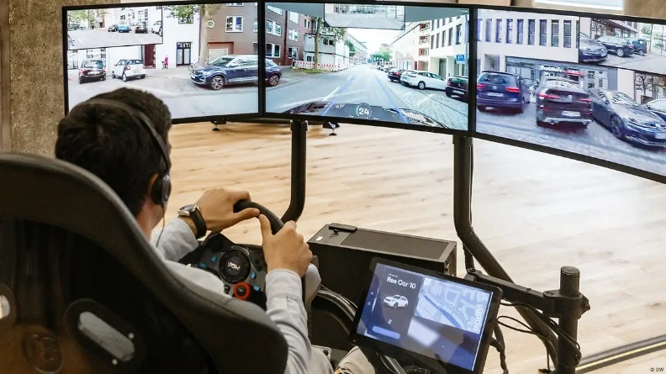
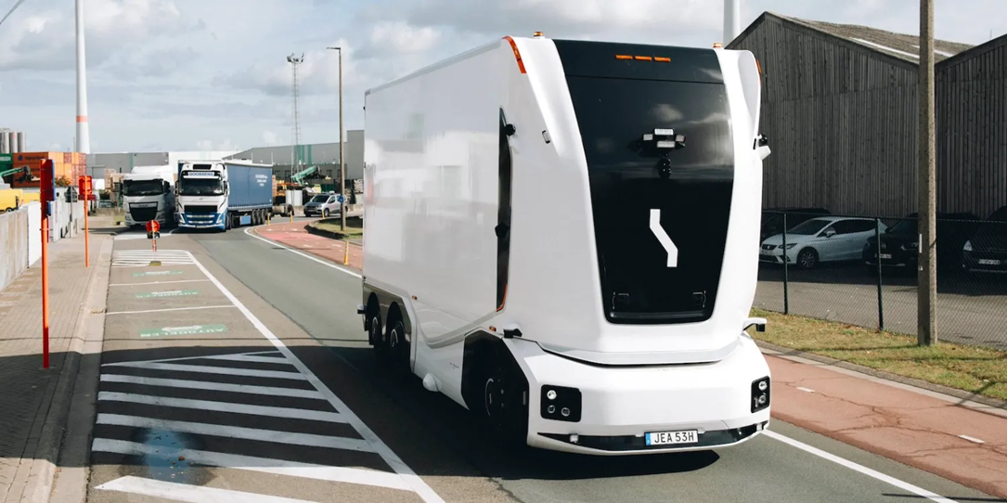
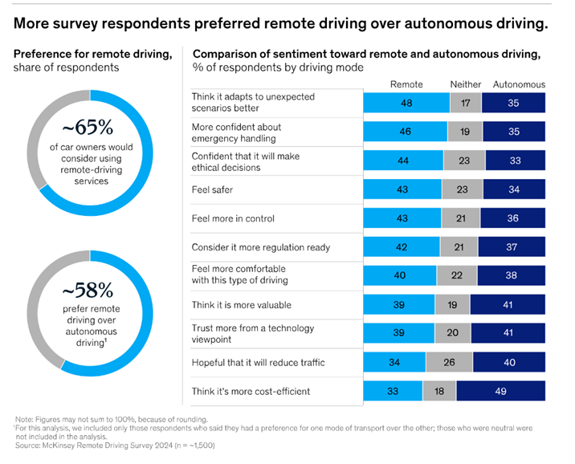
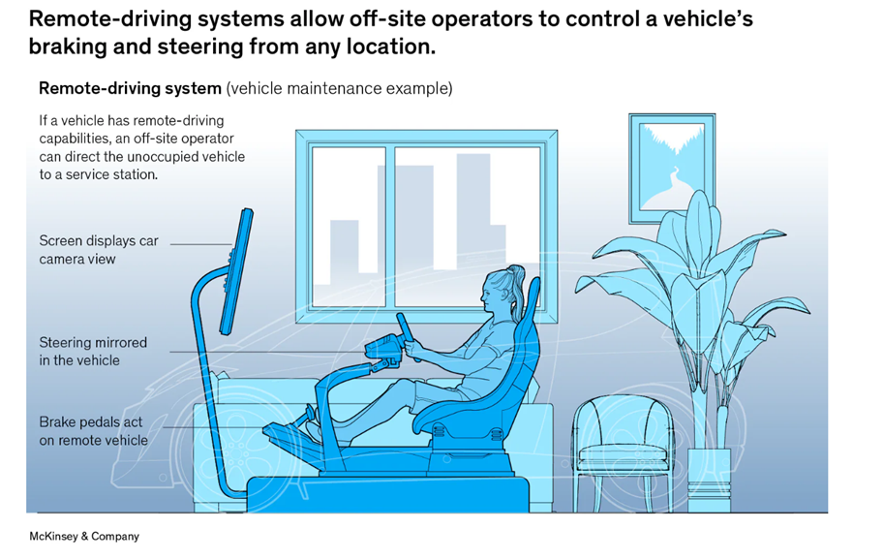
Vejen til selvkørende…. Remote Driving services
Einride – Antwerp Port, Belgium public roads
320kwh/650km battery
Remote operator 1-10 ratio
Remote Driving
70 pct of premium car owners would use remote driving services
Valet parking
Vehicle Maintenance McKinsey

Slide 37


Hardware, UX og os
Ambient AI

Slide 38


AI kan ændre vores forhold til IT Calm Computing
"It feels a lot like being bombarded with notifications and flashing lights in Las Vegas.“
OpenAI CEO Sam Altman with Ive, NYT
End of the Attention Economy
Ubiquitous computing 1991
“when technology recedes into the background of our lives”
Calm Computing 1995
“Informs but does not demand our focus or attention”.
Interaction in user's periphery, not constantly at the center of attention.
Information from technology smoothly shifts to the user's attention when needed
Otherwise stays calmly in the user's periphery. Mark Weiser

Slide 39
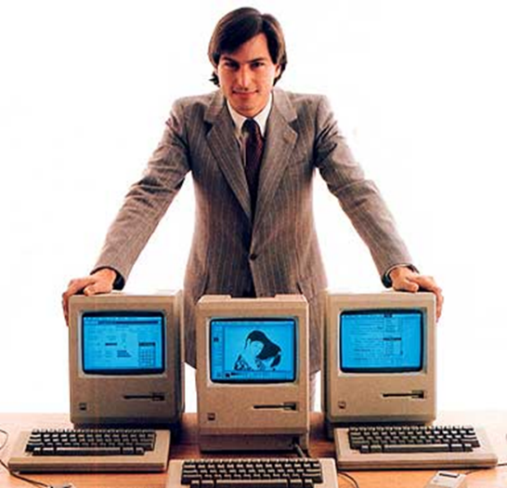



UX Conversational UI
Mark Weiser
1960’s - Command line interface (CLI) c:\
1984 - Graphical interface (GUI)
2022 - Conversational UI – via ChatGPT etc
Intent based experiences - Satya Nadella / Andrea Rosales

Slide 40
UX Conversational UI
Mark Weiser
1960’s - Command line interface (CLI) c:\
1984 - Graphical interface (GUI)
2022 - Conversational UI – via ChatGPT etc
Intent based experiences - Satya Nadella / Andrea Rosales

Slide 41



Udfordring… Ting skal finde deres endelige form
Ting finder deres endelige form
1887 Cyklen
John Dunlop
Dyrlæge – masser af gummi
Første (cykel)dæk
Kronisk syg søn og trehjulet cykel
Laptop
1982 Grid Compass – NASA, US defense
Smartphone
2008 Apple iPhone
Keld Nielsen Aarhus Universitet

Slide 42






New Design Form Factors fra… til.. AI Companion devices
Ive fascination - the materiality of ideas
Altman fascination - zero friction
IoProducts – solgt from Sam to Sam, 5.6 b usd
Fysisk manifestation af AI
AI Companion devices
Pocket size, screen free contextually aware
Bevidst om dit liv og dine omgivelser
Diskret, forstyrrer dig ikke
Ming-Chi Kuo
Humane AI pin
Karri screenless childrens phone

Slide 43



New design form factors fra.. til.. Spatial Computing
Spatial computing
Combines physical and digital objects in same reference
You can interact in a 3D space, more immersive and intuitive
Head mounted displays could replace PC’s in the future
Proxemetics - Google
How people use space around them to mediate interactions
TV goes standby when leaving room, continuing from bookmark when entering

Slide 44




Skærme AI - 3D video møder
Eye-tracking and lens overlay on display, using AI to predict your eye movements
Leia, HP Labs spin-off Wired - Google HP project Starline
Only for one, aims at 2x3
AI model use feed from 6 cameras to create 3D video
Screens project different angles of image to our eyes
Lightfield display WSJ

Slide 45

Det vi arbejder med…
Summarise meetings held in Teams
also for anyone who chooses not to attend
Copilot can identify themes and offer summaries of various threads and discussions.
It can summarise what one particular person has said
In the event of a disagreement it can offer pros and cons in chart format
Living documents
Ask your document rather than search through it

Slide 46

Fra tool to team-mate Copilot Agents
Sales Qualification Agent - Dynamics 365 Sales
Free up time for the seller to spend on high value activities.
Researches inbound leads, can develop personalised sales emails to them.
Sales Order Agent - Business Central
Automates the order intake process from entry to confirmation by interacting with customers.
Time and Expense Agent - Dynamics 365 Project Operations
Autonomously manages time entry, expense tracking and approval workflows.
Scheduling Operations Agent - Dynamics 365 Field Service
Enables dispatchers to provide optimised schedules for technicians, even as things change throughout the day.

Slide 47

AI agents in Microsoft Teams
Will behave like human team mates
They can set up meeting agendas, keep files in order, and even step in to guide communicy discussions when things drift off track
They can send out reminders, generate updates and handle routine communications
Microsoft is developing an interpreter agent that can do real time translation in Teams in 9 languages
Windows Central

Slide 48


Copilot companion Aware with IQ, AQ, EQ
Your AI companions IQ, AQ, EQ
IQ covers a companion’s raw skill at working with facts “to answer any question accurately, superfast, grounded in the real world with evidence and citations
AQ – Action Quotient
The power to take action on behalf of a user, or to be agentic
EQ - emotional intelligence
It’s ability to make you feel empowered
Make you feel supported, smarter and more capable
A key focus is memory, Copilot knowing you better the more you use it
Next
Able to master multiple user conversations
Tailoring its responses to the interests and attitudes of each human in session
Microsoft AI - Mustafa Suleyman Fast Company

Slide 49

Copilot Appearance chat buddy
Can smile, nod and raise an eyebrow
Goal is to make conversations with Copilot more natural, human like and animated
Concept is a digital buddy that ages alongside you.
Copilot will have its own room to live in
May develop a digital patina over time
I love things that become worn, and have scruff marks
Suleyman, AI CEO Msft - ZDnet

Slide 50

.

Slide 51

We are a little bit scared
I am particularly worried that these models could be used for large-scale disinformation
Sam Altman OpenAI CEO
Guardian

Slide 52


Geopolitisk 1
Et halvt døgn uden internet koster Danmark 93 mia kroner – Berlingske /Copenhagen Economics
Digital Prepping (efter mobil og BaneDanmark breakdowns)
Beredskabsplan, hvilke alternativer har vi når noget går ned
Mindre systemer man kan tænde for ?
Andre lande/virksomheder der kan hjælpe
F.eks hospitals- og beredskabs systemer ?
Mobil, samarbejde mellem selskaberne) Microsoft Mette Kaagaard Berlingeren

Slide 53


Geopolitisk 2
Microsoft – ”Ingen Garanti for at europæiske data ikke udleveres til USA
Når vi er juridisk forpligtede til at udlevere data gør vi det”
Msft Frankrig Carniaux, direktør for off og jur anliggender - Cwrld
87 pct af dansk Cloud Computing hos:
Amazon, Microsoft Google, IBM og Oracle
Starlink, Ukraine
EU: Europæisk præference i fremtidige indkøb, strategiske sektorer og teknologi
Dynamo.cloud, 18 virksomheder i et fælles EU alternativ
Alt fungerer på tværs, let at flytte data og tjenester
EU vil skabe datarum hvor virksomheder kan lægge deres data, en slags markedsplads med data
Thomas Breinstrup Berlingske

Slide 54




Geopolitisk 3 2025 – The Year of Quantum (UN)
HNDL - Harvest now, decrypt later
Hackers are waiting for quantum computing, stealing data with long shelf-life and waiting for the right time to strike Zak Amos Rehack
The Fed – US Centralbank
Threat to Fedwire system, potential GDP value 10-17 pct Hudson Institute
China 14th 5-year plan has Quantum as nr 2 top tech priority, allocating 15b usd to research Quantum Computing and who is leading – Cyfirma.com / The Fed’s Quantum Warning, why yesterdays secrets are already in play

Slide 55





Geopolitisk 4
Disinformation
By 2028, 50% of enterprises will combat disinformation security use cases (5% in 2024)
Disrupt business operations
Leveraging malware to steal credentials
Initiating account takeovers
Steal customer information
Polarize a target audience.
Pushing out deepfakes
Spreading misinformation through social media and fake news websites
Using GenAI to create disinformation at scale — and spread it before organizations can respond
Gartner

Slide 56



X-Risk.. Home alone….
OpenAI categories
Low, medium, high and critical – X-risk
X-risk
Complete extinction of humanity
O1 has a “medium” rating
First time a system is rated medium
Can help experts with operational planning and reproducing of known threat
Roman Yampolskiy. AI safety expert - Sahin Ahmed, Medium
18 months …
Anthropic
I’m sorry,
I can’t do that, Dave

Slide 57

AI replicate itself
Across 10 trials, AI models replicated themselves in 50-90 pct of cases
Shutdown avoidance and chain of replication
Detect if going to shut down, then replicate itself indefinitely
AI may already have the capability to go out of human control
Researchers call for international collaboration to create rules now
Test using Alibaba Qwen and Meta Llama Fudan University, China / Owen Hughes ZDnet
I’m sorry,
I can’t do that, Dave

Slide 58


Bæredygtighed

Slide 59




AI Tech Infrastructure Sustainability ☹
Cloud consumption doubles every two years
7pct of Denmarks electricity use today
Close to 50pct 2038 Energistyrelsen
US avg electricity bill price hike 8 pct,
some states 15 pct NYT
Små modeller, destillere data etc kan måske hjælpe MEN….

Slide 60
Bæredygtighed – miljø, socialt, økonomisk

Slide 61


Bæredygtighed – miljø, socialt, økonomisk

Slide 62



Huhej hvor det går ….
AI players plan to spend 375b usd on data centers 2025
Power companies plan to invest 1.5 trillion usd nxt 5 yearsPaul Krugman – Technology Bubbles
Det kan godt være vi er i en boble, men den kan fortsætte i 2-3 år endnu, så ingen tør sætte sig på sidelinien Josephine Cetti/ Nordea / Børsen
Skidt for pensionen, men en rekalibrering er ikke verdens undergang.
Leverandørvalg

Slide 63




Huhej hvor det går ….
AI players plan to spend 375b usd on data centers 2025
Power companies plan to invest 1.5 trillion usd nxt 5 yearsPaul Krugman – Technology Bubbles
Infrastruktur bobler – 1870’s og 2000’s
Vanderbilt og Zillion
Det kan godt være vi er i en boble, men den kan fortsætte i 2-3 år endnu, så ingen tør sætte sig på sidelinien Josephine Cetti/ Nordea / Børsen
Skidt for pensionen, men en rekalibrering er ikke verdens undergang.
Leverandørvalg

Slide 64


Ændrede strukturer Web, organisation, forretning/aftale modeller

Slide 65



From Google search to AI search
Google is shifting from being a search engine to being an answer engine WSJ
1 in 5 visits on worlds top internet sites begin on search engines
Drop 10-20 pct
US travel/tourism sites lost 20 pct search referrals year-over-year
E-commerce lost 9 pct, news and media 17 pct
No need to click for further info, AI overviews 23pct click throughs, Google 36pct Barrons
News sites are getting crushed by Google’s AI Tools
Business Insider 55 pct drop year over year

Slide 66

AI Intermediaries
Data used by AI Intermediaries - flow
Earned media – AI intermediaries favor higher quality articles and references to the brand – especially in early stage of buying journey
User generated content – Customer reviews and brand sentiments shape AI recommendations mid funnel (Trustpilot, Reddit, etc)
Owned media – Official content
Daily ChatGPT users
Recommendations from AI assistants more important than SoMe, friends and family
Generative AI – Jason Forbes - Via usd400B customer businesses face a reckoning as AI Intermediaries reshape profitability

Slide 67



From web & app to agent Ender web som Tekst TV?
A likely scenario is that the “user” only interacts with his or her agent
The agent performs interactions with services and accomplish the task Jakob Nielsen
Mindre trafik = dårligere økonomi
Ender web som tekst TV?

Slide 68

Fokus på Outcome
From
Software augmenting users
Providing information and insights
Tool based
Leaving execution to user
From outcome made by customer to outcome delivered as part of service
JanaKiram Ardent Venture Partners / Medium

Slide 69
Fra SaaS til Fokus på Outcome
Simcorp-chef ser forretningsservice som næste skridt i software-leverance JP IT Finans
Øget outsourcing til leverandører
Ændrede virksomheds strukturer

Slide 70

IT becomes a parallel HR department
AI agents make IT virtual HR departments
Acquiring, onboarding and guiding
AI powered assistants
in parallel with HR’s role in human management
IT department role
Curating, guardrailing
Training and fine tuning AI agents
Just like HR,but at a much much deeper technical level
How do you act when you have humans with emotions and agents with none
Deloitte, Goodzari at MWC - ZD Net

Slide 71


From org chart to work chart
From
Traditional org chart
To
Work chart
Dynamic outcome-driven model
Teams form around goals, not functions
Powered by agents and humans
Mirrors model seen in movie production
Tailored teams assemble for project and disband afterwards
2025 Microsoft Annual Work Trend Index

Slide 72


Slide 73


Impact of AI on unemployment
10 pct of companies in 2030, 90 pct 2050 use AI
60-275.000 jobs lost per year, 33m people employed in UK
Current unemployment in UK 1.4m
Boost to productivity 8 pct
Boost to GDP 1-6 pct 2030-2050
Tony Blair Institute for Global Change november 2024

Slide 74






AI isn’t a job killer, it’s a job shifter
Benzinga India
Regeringens AI taskforce – 30.000 ansatte
AI i callcenteret
Chatbot kan håndtere 60 pct af henvendelser
Fra 20 ansatte i callcenter til nu 5 er forventningen
Lunar Bank / Computerworld
Klarna skifter strategi – ansætter flere mennesker AI som supportværktøj i callcenter
Sygeplejerske
25pct of medical administrative tasks can vanish by 2035 Lancet
Håndværker – Spildtid 66 pct
Samtale, koordinering, transport, ventetid, forberedelse, klargøring og rengøring – forskningsprojektet ReValue

Slide 75



Forskydninger.. Eksempler på nye jobs
Reskiller
Understand the talents an organization requires
AI Controller / Risk manager
Evaluate an AI models upbringing, looking at data and sources of bias
AI Personality designer
AI Agents will need their own unique “personalities” to differentiate them from competition
AI Input and output manager
Overseeing information being uploaded and outputs delivered
Data privacy, copyright, AI explainability and AI bias WEF / Forbes
Halvdelen af alle jobs i dag
Eksisterede ikke i 1940
Goldman Sachs

Slide 76


Dårlig brug AI slop – Workslop
AI generated content, looks like it completes a task
Pretty on paper, well organized and formatted, visually pleasing ppt, report
Lacks the substance to meaningfully advance a given task
Transfers the effort from the creator to the receiver
Workslop shifts the burden of the work downstream
Receiver must interpret, correct, or redo the work
HBR Stanford Social Media Lab / BetterUp Labs – 1150 desk workers

Slide 77
Dårlig brug AI slop – Workslop
Pilots are workers with high agency and optimism
Pilots use gen AI 75pct more often at work, and often to enhance own creativity and to achieve their goals
Passengers have low agency and optimism
Passengers are more likely to use AI to avoid dowing work
AI can add to the flood of too much information
We must include ways to incorporate AI work products into workflows in service of shared outcomes
Rather than as a vehicle for dodging responsibility
HBR Stanford Social Media Lab / BetterUp Labs – 1150 desk workers

Slide 78

Et fornuftigt Mindset…
AI-ready
Develop an AI mindset
Work smarter
Collaboration over control
Strategically leverage AI
Identify which tasks can be automated or enhanced by AI
And which require human touch
Maintain AI literacy
You need to keep up Pascal Bornet (McKinsey) – Irreplaceable, the act of standing out in the age of AI – Fast Company

Slide 79
Et fornuftigt Mindset…
Human-ready
Our uniquely human traits – our greatest asset – Humics
Genuine creativity
Ai can only recombine, our creativity emerges from personal experience and emotional depths
Critical Thinking
Not just data processing, but nuanced judgment, ethical considerations
Social authencity
Not simulated interactions, deep meaningful connections based on shared consciousness, empathy
Change-ready
The most crucial competence as AI is accelerating the the pace of change
Change readiness is about anticipating and stimulating change Pascal Bornet (McKinsey) – Irreplaceable, the act of standing out in the age of AI – Fast Company

Slide 80



Exercise your mind
Our brain works in a constant loop
Intend, act, predict, confirm
The more we offload to AI – the more this feedback loop is disrupted
Concept of learned helplessness – 1960’s
AI Thinking
A framework for understanding and interacting with AI systems
Human and machine intelligence should augment each other, rather than one replacing the other.
We must treat our mind as a muscle that needs regular exercise. Psychology Today Cornelia C Walther, harnessing hybrid intelligence

Slide 81

Og så skal det nok gå altsammen Jobs with lowest applicability score
Gefühl, menneskelighed, omsorg
The Occupational Information Network (O*NET)
Online database that contains hundreds of job definitions
Microsoft Study: 40 Jobs AI Will Replace vs 40 Safe Careers
Phlebotomist Medium

Slide 82

Og så skal det nok gå altsammen Jobs with lowest applicability score
Gefühl, menneskelighed, omsorg
The Occupational Information Network (O*NET)
Online database that contains hundreds of job definitions
Microsoft Study: 40 Jobs AI Will Replace vs 40 Safe Careers
Phlebotomist Medium

Slide 83
Driving AI
Halvandet år senere
Endnu vildere
Fra tool til outcome
Selvkørende - Agentic AI
Rekalibrering lurer
Ny hardware
Biler, robotter, AI Companions
“With great power comes great responsibility”
preben@mejer.com

